Slide 1
Flood Protector

Slide 2
Submitted By:
Ashiqul Islam Ashik 170204070
Shweta Bhattacharjee 170204111
Umma Salma Anika 170204113
Sadman Jahin 170204115

Slide 3
Objective
We live in a developing country like Bangladesh where we face lots of difficulties now a days. In the century of urbanization we still rely on agriculture and rural peoples. In that cases people suffers most are flood and famine .If we focus on our Geo-location we are quite unlucky that we are surrounded by Hill Tract, Himalayan Countries . Heavy Rainfall causes too much drain of water and people watch their area, crops ,livestock flooded all of a sudden.
So, we came up with an idea which is microcontroller based system named “Flood Protector” which can measure water level by using sensor probes to indicate water levels in a drain, estuary etc ; There are 3 levels of water. One is Safe zone, another level is unsafe zone finally danger zone. Our system will aware general people and authorities from upcoming hazards so that people can move themselves into secure region.

Slide 4
Social Impact
Our Flood Protector can be used in Drain which is connected to river, in Dam, in making drainage system of a town, for the farmers to ensure the safety of their golden crops from flood water etc.
Flood Protector will automatically open the gate when water flows in the safe zone. When the water level increase and water flow in the unsafe zone our system automatically beeping and warn people about upcoming flood. When water flows in danger zone the gate will be closed and extra water will not come.
In Dam to protect the village from flood.
In the ship compartment , if there is some leakage under the ship and water comes into the ship, our system help to closed the gate and doesn’t allow water to enter, this can keep other compartment safe and also protects the ship from drowning.

Slide 5
Features
Our project contains lots of features. So it secures
Safety Of The People
System Failure Alert
Urgent Signal/Warning
Water Flow Management
Water Depth Analysis
Automated Gate System
Two Step Security Behind Gates
Low Cost Implementation
Easy To Handle

Slide 6
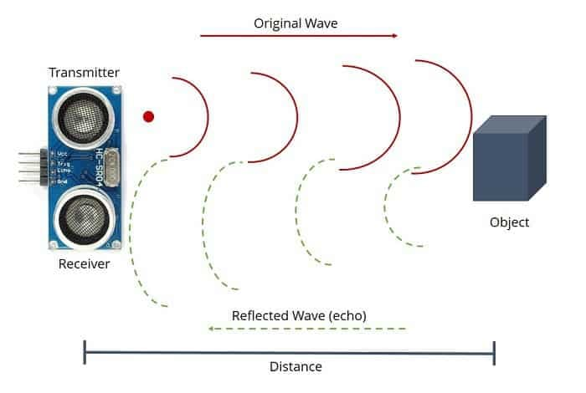
How we measure depth of water?
Mentioned sensor is useful to measure depth of water and we will analyze the value in our arduino-r3. Generally the sensor’s working procedure is it sends a waves signal, if there is any object in front of it the signal gets reflected and receiver receives it and returns a value respect to signal response time else it returns null value. That’s how we will measure the distance or depth.

Slide 7
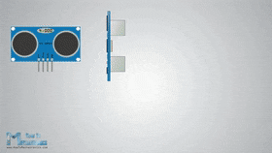
Working Procedure of Ultrasonic Sensor

Slide 8
Components
Arduino UNO R3 x 1
Ultrasonic Sensor x 1
NPN Transistor BC548 x 1
5V Buzzers x 1
LCD Display (16 x 2)
Resistors with different Resistance
Plastic glass x 1

Slide 9
Components
ESP8266 x 1
LED(Green ,Red ,Orange) x 9
Berg Strip Female x 2
Connecting wire (male , female)
Bread Board(6.5”x2.125”)
5V , 1A mobile charger as power supply
5V DC Motor
Long 6 inch, width 3 inch metal sheet x 1

Slide 10
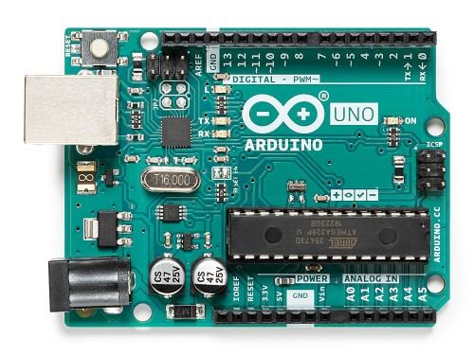
Components
ARDUINO UNO R3
The Micro Controller we are using in this project is Arduino R3 which will help us to handle logical problems easily. Arduino R3 provides 13 Digital Pins and 5 Analogue Pins for various inputs and Outputs.

Slide 11
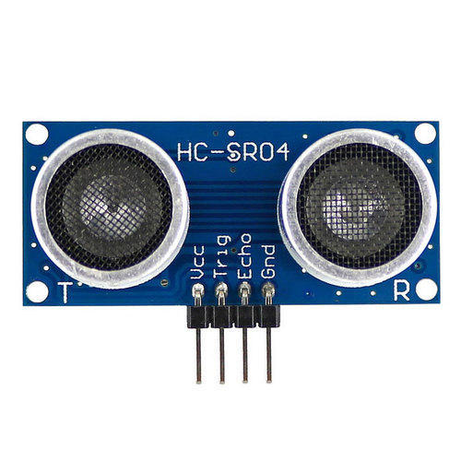
Components
Ultrasonic Sensor
An ultrasonic sensor is an electronic device that measures the distance of a target object by emitting ultrasonic sound waves, and converts the reflected sound into an electrical signal. We will use ultrasonic sensor to check if the water of river , drain is full continuously.

Slide 12
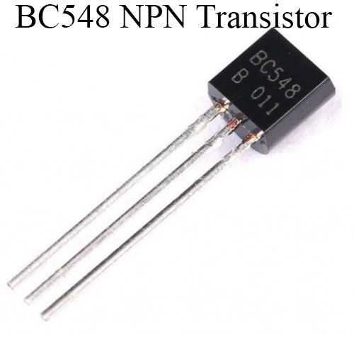
Components
Transistor BC548
BC458 is a general-purpose NPN transistor used in many electronics projects and devices. BC548 transistor is used for amplifying and switching purposes in electrical circuits. Like every other NPN transistor, it consists of three pins: the collector, base, and emitter.

Slide 13
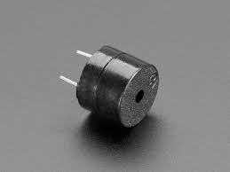
Components
5V Buzzer
As we have mentioned we are keeping three zones for security purposes. Buzzer will be needed when water level reaches to the unsafe zone.

Slide 14
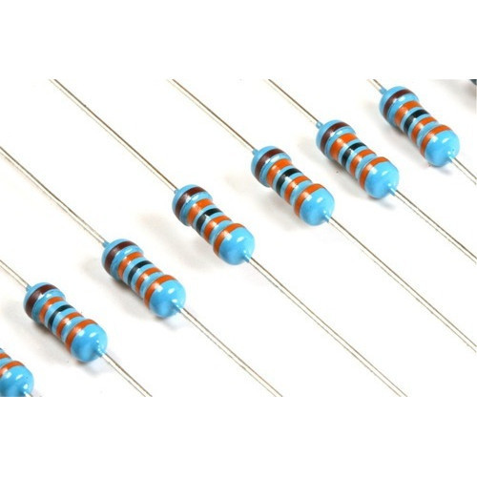
Components
Resistors with different resistance
Resistor will be connected between LED and Arduino for keeping safe current limit which will refrain LED from burning.

Slide 15
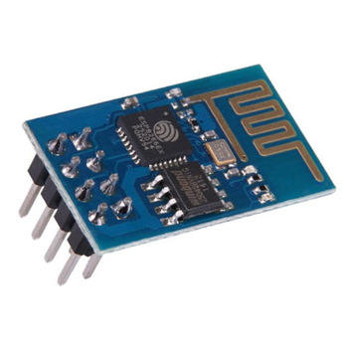
Components
ESP8266-01
The ESP8266 ESP-01 is a Wi-Fi module that allows microcontrollers access to a Wi-Fi network. This module will connected to Arduino which will connect us with a SmartPhone to control the whole system.

Slide 16
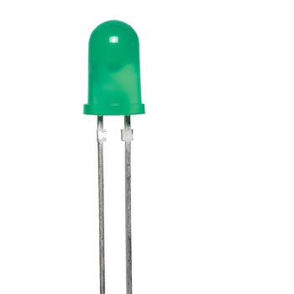
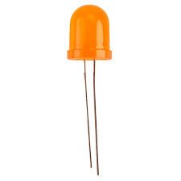
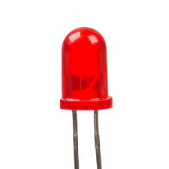
Components
Green , Red, Orange LED
LEDs are commonly used for indicator lights . As we have mentioned we are keeping three zones for security purposes. We will be use LED for indicate three stages to be mentioned Green LED for safe zone, Orange LED for unsafe zone and RED LED for danger zone. Two Blinking Red LED will indicate Critical situation.

Slide 17
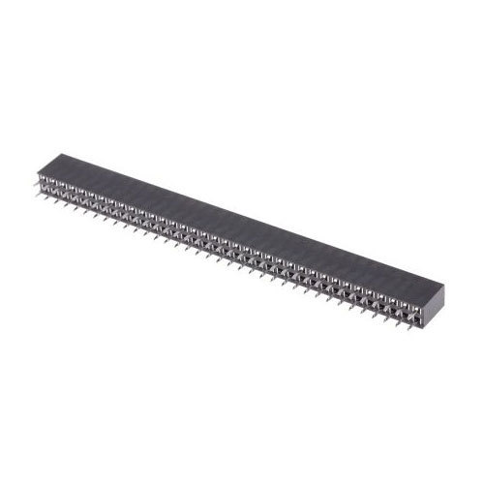
Components
Berg Strip Female
Berg Strip is a commonly found connector in all kind of circuit boards. It is also called as Berg Stick because of its stick like structure. The Berg Strip is very light and compact and it can be easily assembled to a circuit board.

Slide 18
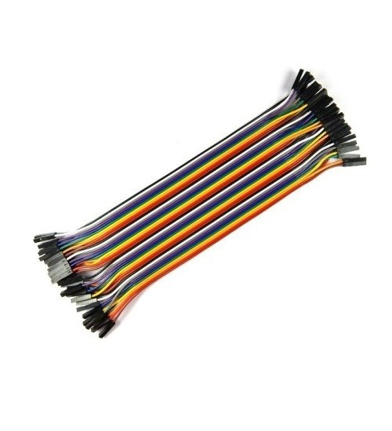
Components
Connecting Wire
Connecting wires provide a medium to an electrical current so that they can travel from one point on a circuit to another. In the case of computers, wires are embedded into circuit boards to carry pulses of electricity.

Slide 19
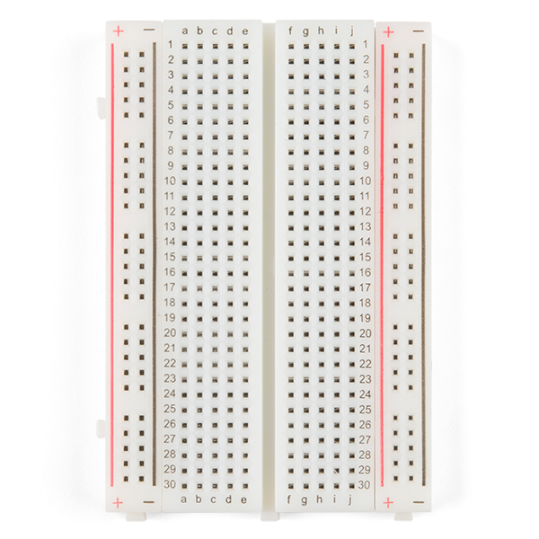
Components
Bread Board
A Bread Board, is used to mechanically support and electrically connect electronic components using conductive pathways, tracks or signal traces etched from copper sheets laminated onto a non-conductive substrate.

Slide 20
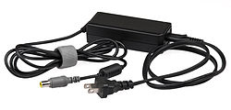
Components
DC Charger
A DC Charger for electronic devices. power adapters plug into a wall outlet and convert AC to a single DC voltage. We are going to use 5v-1A DC Charger.

Slide 21
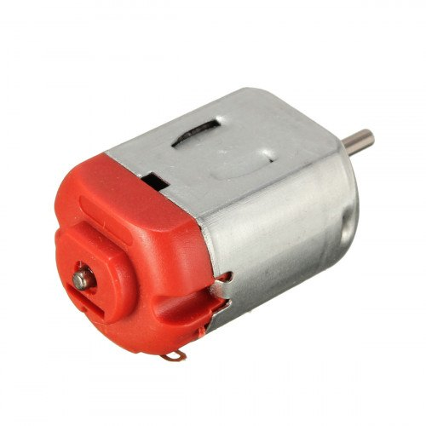
Components
DC Motor
A direct current (DC) motor is a type of electric machine that converts electrical energy into mechanical energy. DC motors take electrical power through direct current, and convert this energy into mechanical rotation . We are going to use 5V DC motor.

Slide 22
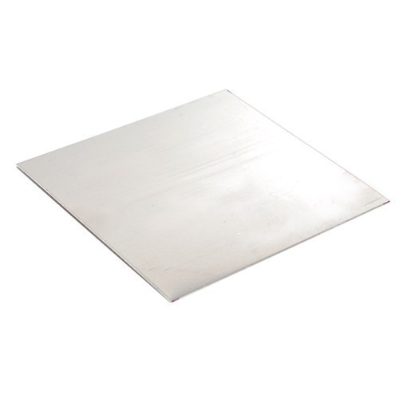
Components
Metal Sheet
Metal sheets are generally categorized as thin sheet and heavy plate . We are going to use long 6 inch and width 3 inch metal sheet.

Slide 23
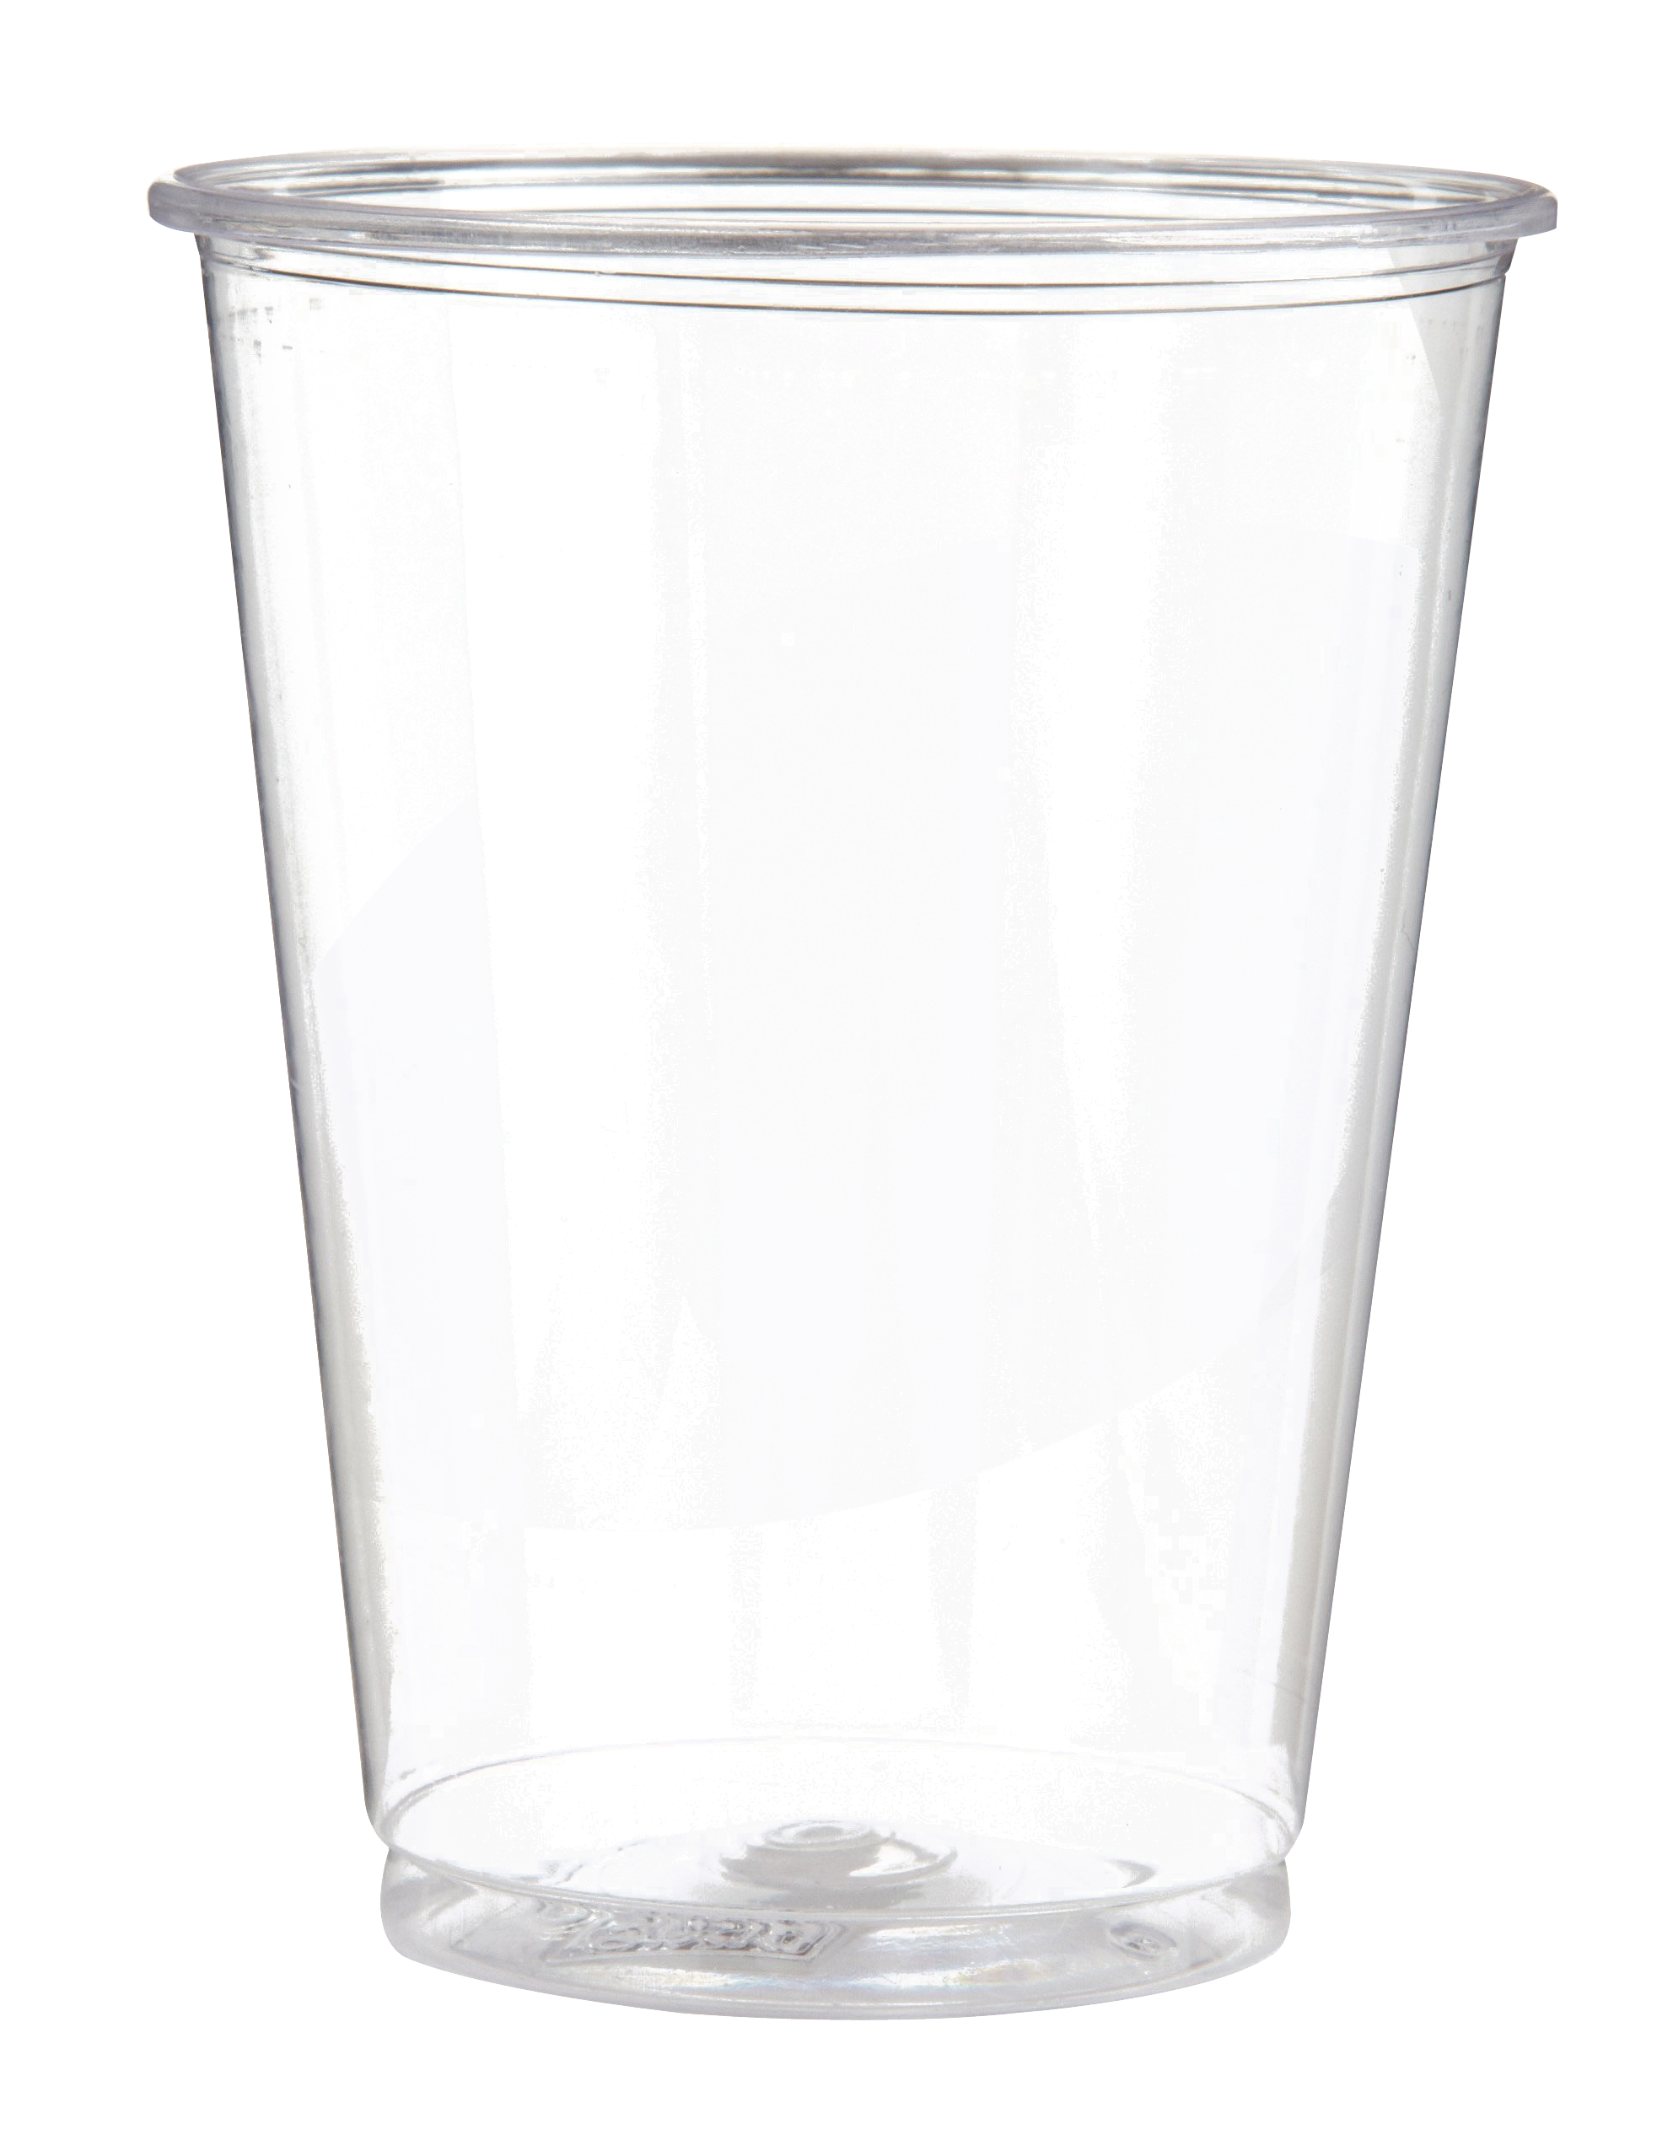
Components
Plastic Glass

Slide 24
Benefits Of Flood Protector
Power Saver
Living in an age where we need to be more conscious of the energy that we use, a water level controller is ideal at saving power. Normally, regulating water levels can consume electricity and wastewater. However, with automatic controllers, the electricity.
Low cost
There are lots of people needed for the earlier project which cost a lot of money. Our new budget plan and automated project will reduce a vast amount of cost.
Improvement Of Agricultural Output
Our famine and flood visited regions does not yield crops for some seasons. Our system will improve water flow environment as well as crop production.

Slide 25
Thank You

